Slide 1

Exploration & Experimentation of Applying Machine Learning Methods to Coral Microbiome Data
Cassandra Sperow, MS Data Science Candidate
Data 793: Data Science Practicum
Final Presentation
December 4, 2023
Client: Dr. Anny Càrdenas, American University

Slide 2
Introduction

Slide 3


Project Overview
Project Overview
Relationships between coral algae and bacteria provide insight into the algal symbiont, i.e., the wholistic interaction of algae and bacteria within coral tissues that work to regulate nutrient cycling and resilience to thermal or environmental changes.
Part I: Unsupervised: Identify bacterial groups that tend to cluster together to understand the bacteria-algae partnerships present in corals sampled from several regions in the Red Sea.
Part II: Supervised: Estimate the association between algae of clade C and its bacteria by using machine learning algorithms to predict if a sample’s bacterial profile is Clade C or not.
Project Goals

Slide 4



Research Questions
Part I: Unsupervised Machine Learning
Which bacteria strains tend to be clustered together?
Part II: Supervised Machine Learning
Which bacteria are associated the most with algae of clade C?
Which bacteria could be the ‘best’ predictors of clade C?

Slide 5

Literature Review
Logistic regression is conventionally used in medical diagnosis using bacteria and other types of observational variables from patient records to predict ‘healthy’ or ‘not healthy’ diagnoses.
Even though data may not be linear, logistic is still used because of its high interpretability to see contributing factors in diagnosis outcome (Ex: 0 = healthy, 1= disease)
Biologic sequencing data are by nature compositional, meaning that they are not linearly independent. Data are dependent.
This violates underlying assumptions of statistical methods.
See last slide with References

Slide 6

Data

Slide 7
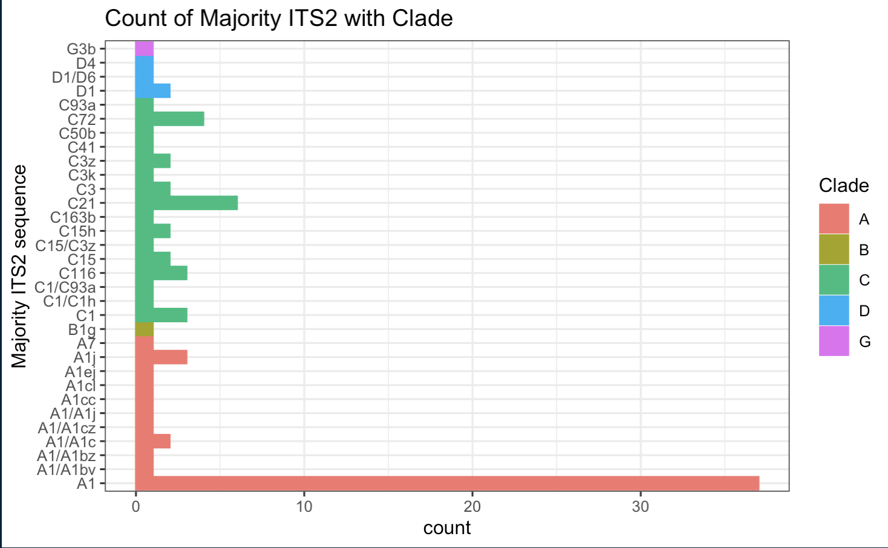
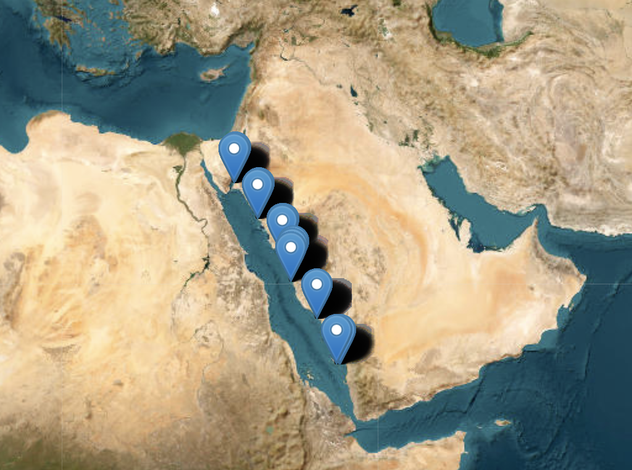
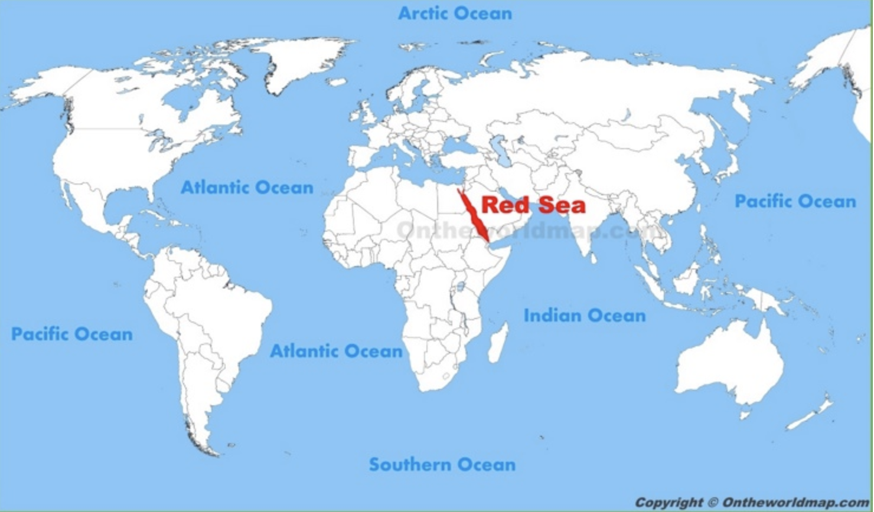
Data Overview
Clades A and C are the most prevalent, respectively.
Two species:
Stylophora pistillata
Pocillopora verrucosa
Total samples: n = 659
Algae Types: 88
Algae Clades: 5
Original bacteria ASVs = 33,173
Total ASVs in at least 3 samples = 5,889
Average of 204 unique bacteria per sample
6 unique regions
Saudi
Arabia
Egypt
Red Sea
ASV = Amplicon Sequence Variant, i.e., bacterial strain species
Data source: Buitrago-López, Cárdenas, et al. (2023). Disparate population and holobiont structure of pocilloporid corals across the Red Sea gradient demonstrate species-specific evolutionary trajectories. Molecular Ecology. 2023;32:2151–2173. DOI: 10.1111/mec.16871

Slide 8
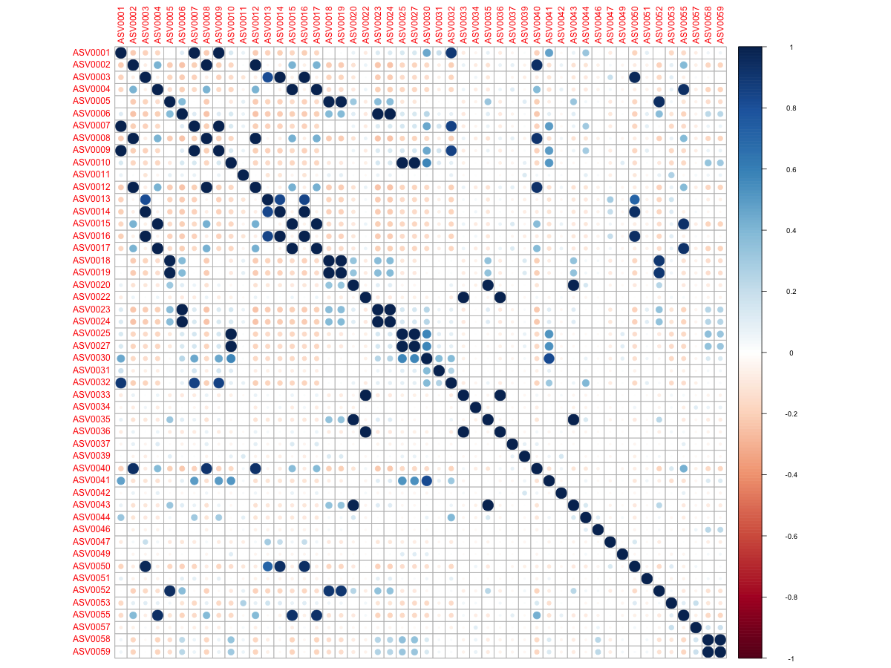
Correlation Plot of Top 50 ASVs
The ASV numbers are ranked in terms of abundance, e.g., ASV0001 is the most abundant over all samples.

Slide 9
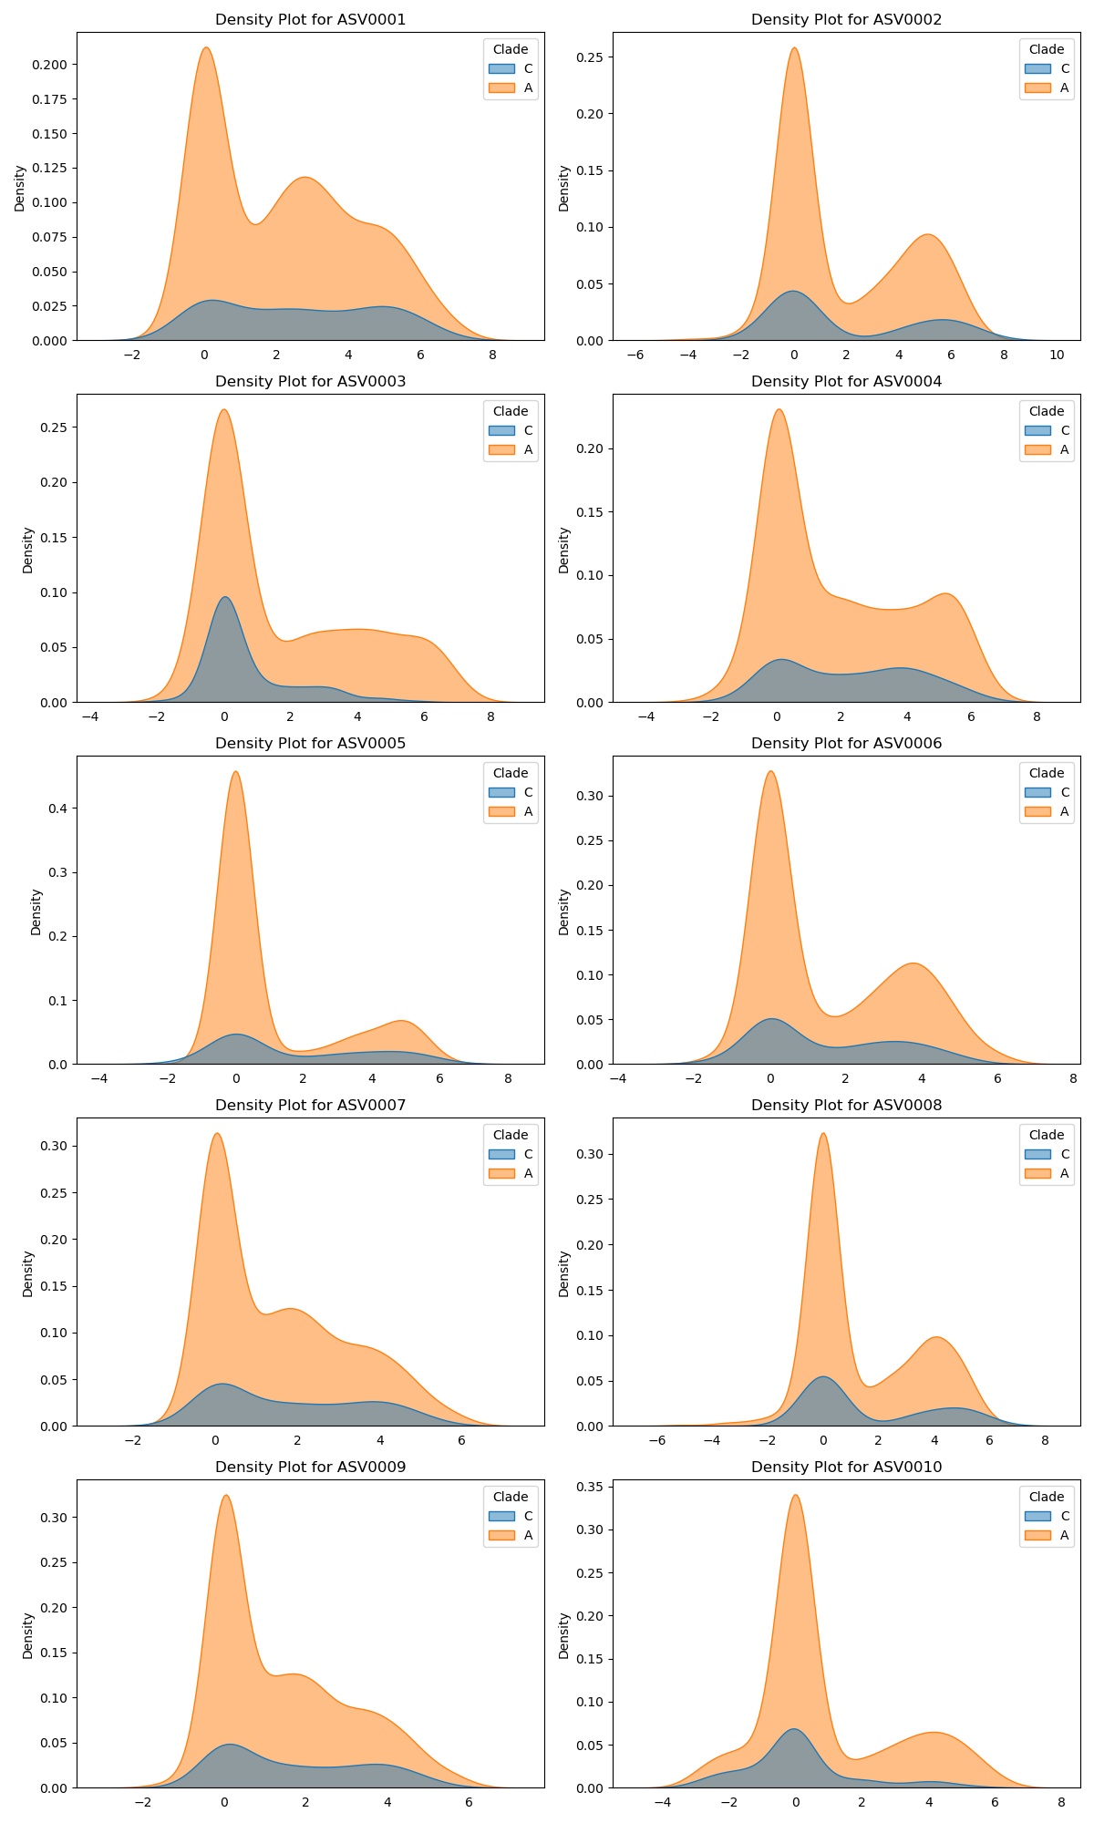
ASVs 1, 7, and 8 are highly correlated in the previous plot and in terms of their densities.
Distributions are overlapping which plays a role in modeling for predicting Clade C.
Density Plots of First 8 ASVs
Orange = Clade A
Blue = Clade C

Slide 10
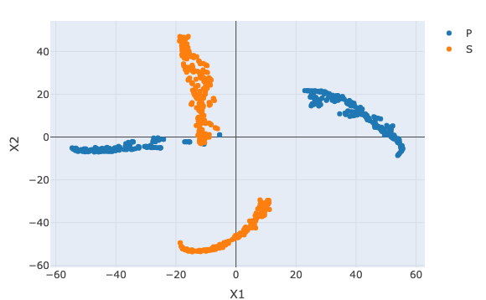
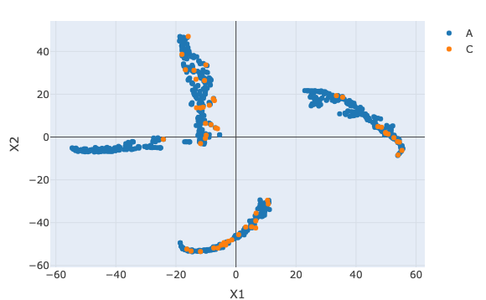
t-SNE Plots of 1000 Top-Ranked ASVs
Fig 1: by Species
Fig 2: by Clade
Both plots indicate extremely non-linear data.

Slide 11
Part I: Unsupervised
Client Question:
Which ASVs tend to be clustered together?

Slide 12

K-Means Seed Experiments
Part I: Unsupervised
All K-means runs were performed using the ‘coseq’ library where the parameters are the same except for the seed:
Seeds: 23, 105, 12
K = 2:50
Transformation = “logclr”
Model = “kmeans”
Nstart = 100
Iter.max = 1000
All 6 run results saved as `.rds` files in ‘output’ folder on GitHub
Species P
Species S
Seeds: 23, 105, 12
Seeds: 23, 105, 12

Slide 13
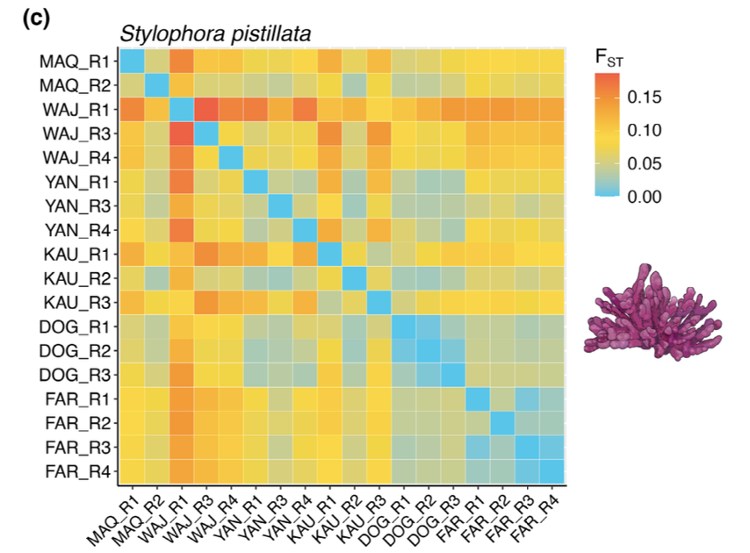
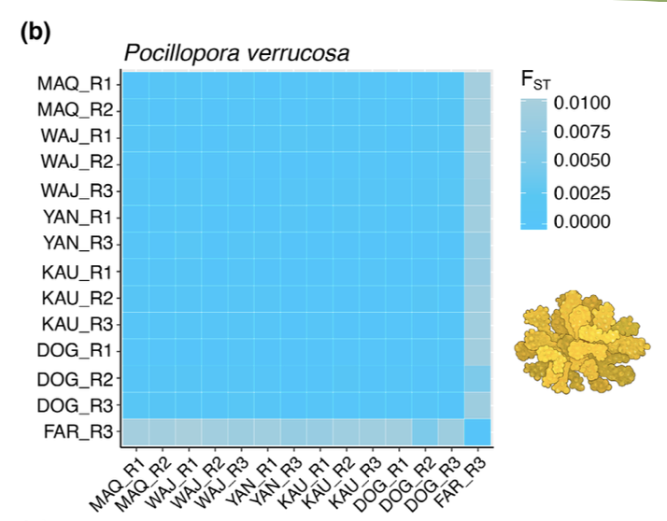
Results: Unsupervised Clustering
Part I: Unsupervised
Species S
Seed 23 = 17 clusters Jaccard: Runs 1 & 2: 0.417
Seed 105 = 8 clusters Runs 1 & 3: 0.412
Seed 12 = 7 clusters Runs 2 & 3: 0.875
Species P
Seed 23 = 12 clusters Jaccard: Runs 1 & 2: 0.923
Seed 105 = 13 clusters Runs 1 & 3: 0.923
Seed 12 = 13 clusters Runs 2 & 3: 1
Jaccard Index calculations indicate highly consistent clustering for Species P in 3 out of 3 random runs.
Did Species P’s different genetic profile assist with more consistent clustering? This is a question for further research.
Images above credited to: Buitrago-López, Cárdenas, et al. (2023). Disparate population and holobiont structure of pocilloporid corals across the Red Sea gradient demonstrate species-specific evolutionary trajectories. Molecular Ecology. 2023;32:2151–2173. DOI: 10.1111/mec.16871

Slide 14
Part II: Supervised
Client Question:
Which ASVs are most associated
with Clade C?

Slide 15
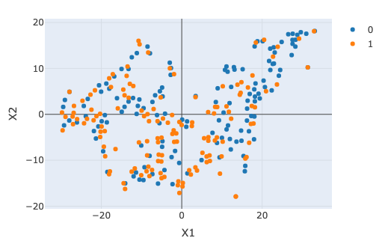
Part II: Supervised
Clade C Bacteria
0 = Non-Clade C
1 = Clade C
Data are not linearly separable
ASVs = 3,226
n = 278

Slide 16
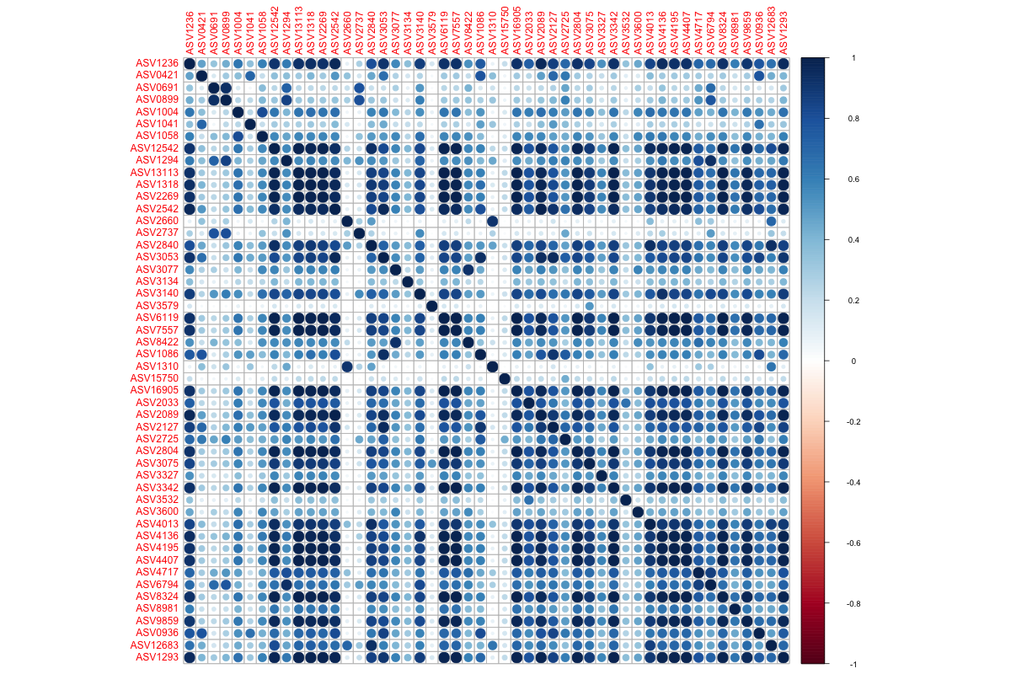
Correlation Plot for Clade C Bacteria
Top 50 ASVs in Clade C from Principal Components Analysis (PCA) Dimension 1 (very different from overall plot in slide 8)
These top 50 seem either positively correlated or not really at all.
Pretty much none here seem to be negatively correlated, at least in this plot.
Part II: Supervised

Slide 17

Methods of Classification:
Part II: Supervised
All model methods were run with the top 1000, 500, and 200 ASVs in order of PCA results for Clade C in Dimension 1 to reduce dimensionality and multicollinearity in modeling.
Ridge
Lasso
Random Forest
Boosted Trees
Model methods were chosen based on Literature Review for interpretability.

Slide 18

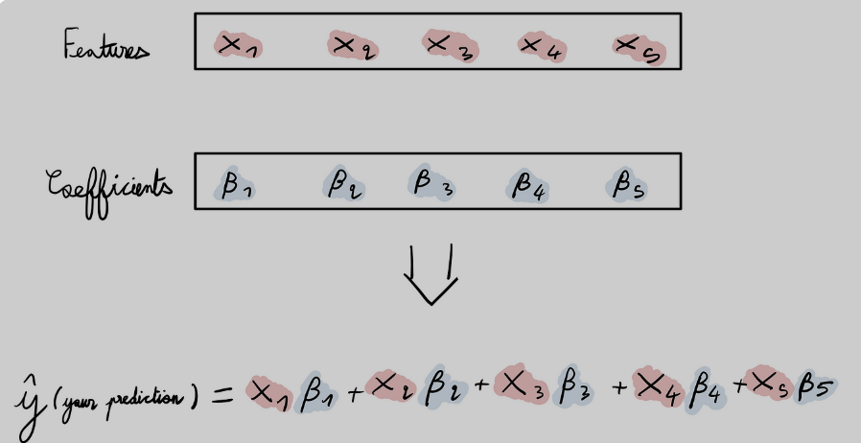
Ridge & Lasso Comparison
Part II: Supervised
Ridge - Recommended model
Lasso
Keeps all predictors
Shrinks least relevant predictors by approaching 0
‘Best’ Ridge 200 resulted in 208 non-zero predictors (including Intercept), of which 200 are ASVs
Error rate: 15.5 %
Selects only relevant predictors
Deselects by setting coefficients = 0 This cancels out certain ASVs as predictors, often used as variable selection.
‘Best’ Lasso 1000 resulted in 24 non-zero predictors (including Intercept), of which 17 are ASVs
Error rate: 15.1 %
Image credit: Towards Data Science

Slide 19
Modeling Results:
Part II: Supervised
All models include 3 non-ASV predictors: ‘region’ and ‘species’ are categorical; ITS2 count (numeric) is the algae abundance count → decreased the error rates.
Classification Method | Best for Linear or Non-Linear | Error Rate 1000 ASVs | Error Rate 500 ASVs | Error Rate 200 ASVs | Cross Validation Method
Ridge | Linear | 28.0 % | 28.8 % | 15.5 % | Lambda.min K-folds = 10
Lasso | Linear | 15.1 % | 15.8 % | 15.5 % | Lambda.min K-folds = 10
Random Forest | Both | 37 % | 29.5 % | 18.7 % | Out of Bag
Boosted Trees | Both | 22.5 % | 23.5 % | 29.3 % | K-folds = 10
Recommendation:
Ridge 200 to have all ASVs kept in model.
Ridge 200
- has similar low error rate,
- retains all ASVs,
- provides higher interpretability, &
- is less expensive for computational purposes.
278 x 1003
278 x 503
278 x 203
Lasso 1000 model only retained 17 ASV predictors out of the 1000, not counting Intercept and categorical variables.

Slide 20

Observations from Modeling:
Part II: Supervised
Interpretability was a higher priority for the client to see how each ASV contributed or not to the model.
Ridge & Lasso performed overall better than tree methods, which was unexpected as tree methods usually handle non-linear data well.
The Ridge 200 non-zero predictors can be reviewed by the client as possible important contributors for Clade C.
Closer examination of these ASVs is warranted to see if they make biologic sense. For example, the client mentioned being familiar with ASV0013.

Slide 21
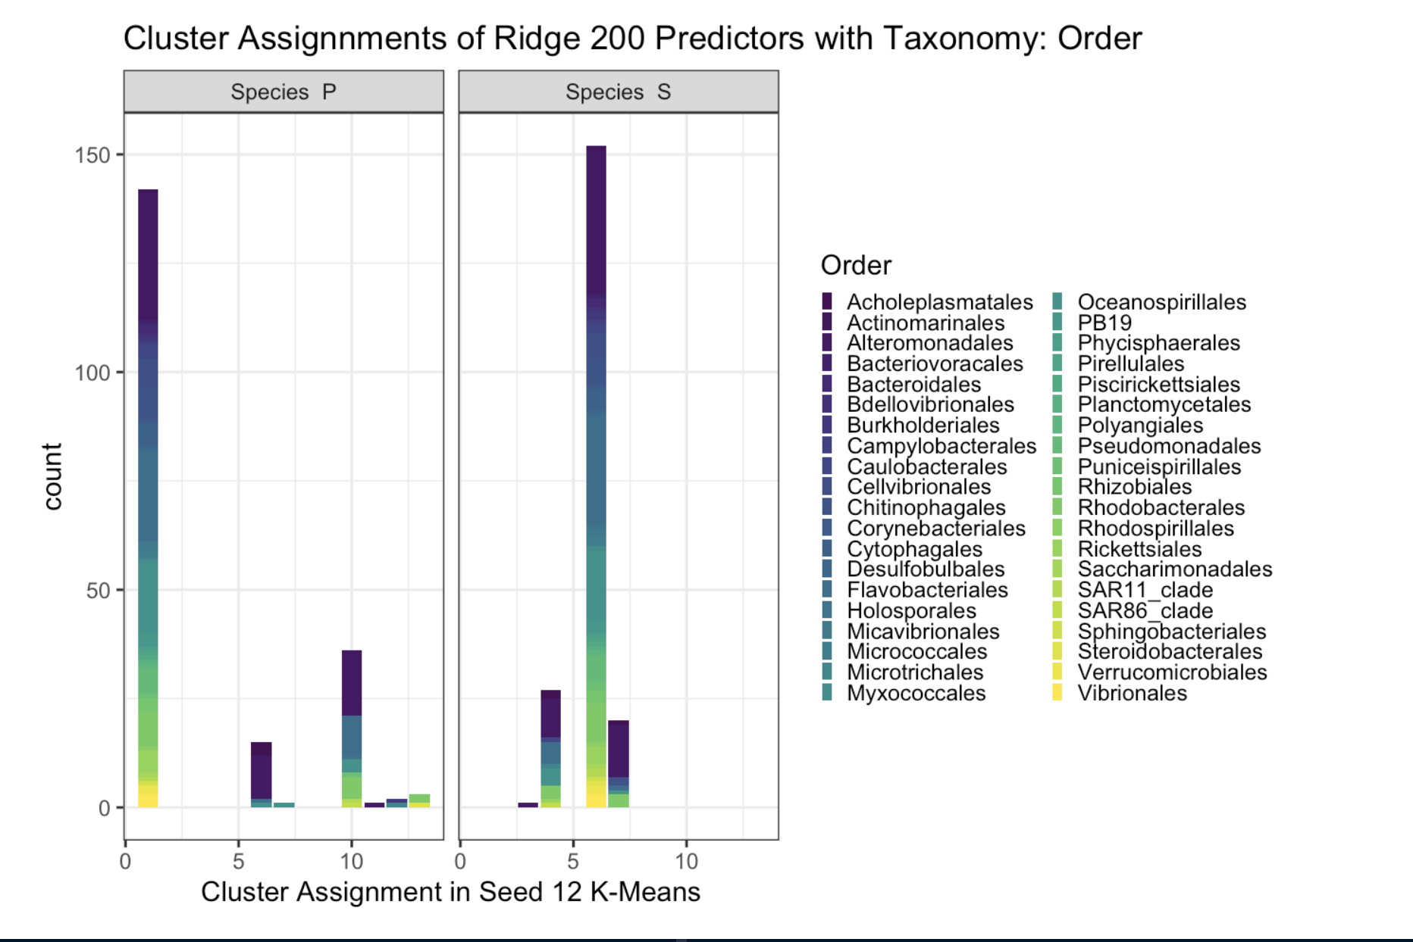
What does it all mean?
The Ridge 200 model’s ASVs as predictors were predominantly clustered in one group.
Ex: ASV6296, ASV4003 are positively associated with Clade C and clustered together 3 out of 3 times. Does this make biologic sense?
Recommendations to Client:
Review ASVs from Ridge 200 in relation to client’s subject matter expertise and knowledge about Clade C.
Review how the Clade C predictors were clustered together.
Cluster 1 for Species P in Seed 12 run
Cluster 6 for Species S in Seed 12 run
Cluster 6
Cluster 1
Seed 12 is shown because the clustering results were largely consistent across all 3 runs. See slides 12-13.

Slide 22


Future Research
Label samples as ‘bleached’ or ‘not bleached’
Species P has a different genetic profile, and this could play a role in the performance of K-Means clustering and model performance
Model with ASVs collapsed at the Genus level; use feature engineering to combine features; and/or add temperature or other environmental data
Gaussian Mixture Models, Support Vector Machines and Neural Nets could be explored, but interpretability will not be ideal
Geostatistical methods, such as kriging

Slide 23

Questions?

Slide 24
References
Armstrong, G., Rahman, G., Martino, C., McDonald, D., Gonzalez, A., Mishne, G., & Knight, R. (2022). Applications and comparison of dimensionality reduction methods for microbiome data. Frontiers in bioinformatics, 2, 821861.
Buitrago-López, Cárdenas, et al. (2023). Disparate population and holobiont structure of pocilloporid corals across the Red Sea gradient demonstrate species-specific evolutionary trajectories. Molecular Ecology. 2023;32:2151–2173. DOI: 10.1111/mec.16871.
Jasner, Y., Belogolovski, A., Ben-Itzhak, M., Koren, O., & Louzoun, Y. (2021). Microbiome preprocessing machine learning pipeline. Frontiers in Immunology, 12, 677870.
Namkung, J. (2020). Machine learning methods for microbiome studies. Journal of Microbiology, 58, 206-216.
Shi, Y., Zhang, L., Peterson, C. B., Do, K. A., & Jenq, R. R. (2022). Performance determinants of unsupervised clustering methods for microbiome data. Microbiome, 10(1), 1-12.
Zhou, Y. H., & Gallins, P. (2019). A review and tutorial of machine learning methods for microbiome host trait prediction. Frontiers in genetics, 10, 579.

